Slide 1
Reliability Solutions Seminar Managing and Improving Reliability
Martin Shaw – Reliability Solutions www.reliabilitysolutions.co.uk

Slide 2
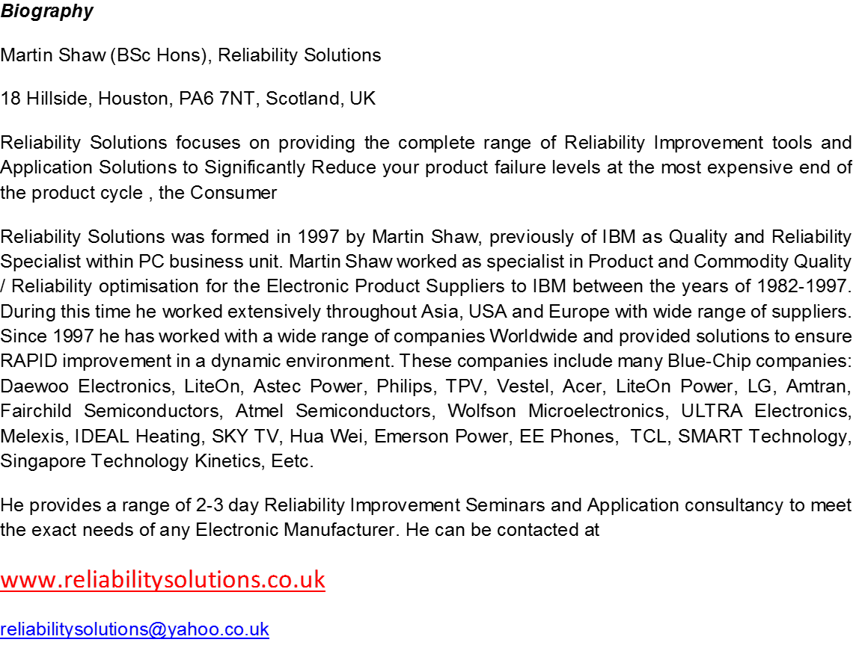
Reliability Solutions – Background

Slide 3
DAY 1 - AM Agenda

Slide 4
DAY 1 - PM Agenda

Slide 5
DAY 2 - AM Agenda

Slide 6
DAY 2 - PM Agenda

