Slide 1

Managing and Improving Reliability across the Entire Life Cycle
From prototype into volume manufacture
2019 Agenda
Martin Shaw – Reliability Solutions
www.reliabilitysolutions.co.uk

Slide 2
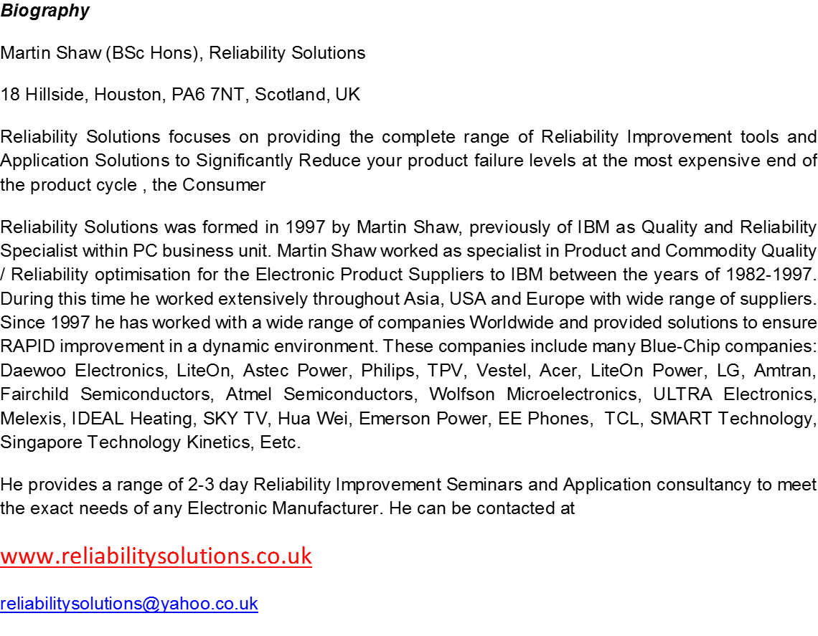

Reliability Solutions – Background

Slide 3
DAY 1 - AM Agenda
Introduction to Basic Reliability Understanding Mod 1
Understanding Accelerated Testing to set up Predictive Testing Models at Design Stage Mod 2a
  High Temp Arrhenius model and Activation Energies used for key component failure modes
  Maximising Acceleration Factors by combining Temperature, Thermal Cycling, Power Cycling and Humidity
  Real Life examples of how to calculate Activation Energy level from experimental work at Product and
  Component level
Applying Acceleration models for a range of product types Mod 2b
  Semiconductor packaged device
  Complex Power Supply
  Mechanical drive motor assembly
  Attendees are expected to bring details of their own product types for developing their own acceleration models and will be provided with the XL software in advance of training . They will need to bring their own laptops
  Evaluating the effectiveness of different stress test types with the Hughes Test Strength Equation to optimise Early Life Test programmes Mod 3
    Developing an Effective Reliability test Strategy , using Modern stress techniques, including Random Vibration and Thermal Cycling
    Product Level Case Study with real life examples using the FREE Reliability Solutions calculation models
Life Test Planning Mod 6
  Theory behind classical Life Testing set up
  Using the FREE Reliability Solutions calculation models to combine Acceleration Factors / Sample Sizes / % confidence predictions

Slide 4
DAY 1 - PM Agenda
Understanding the Statistics and Probability of Failure to define optimum Reliability test Sample Sizes Mod 15
  When is a sample size TOO SMALL to evaluate and qualify product reliability
  Understanding the ‘real’ cost of minimising reliability test budgets
  Real Examples of NOT testing enough products and the negative impact
Relationship of Manufacturing Yield with Early Life Failure Rate Mod 4
  Using yield performance data from PCBA and Product Assembly processes to Predict Warranty Field Fail Rates
  How to predict and control Early Life Failure Rates using manufacturing data , Case Studies using the FREE Reliability Solutions calculation model
Electronic Sub-Assy Reliability Stress Testing Mod 7a
  Making Reliability more effective at Sub-Assy level
  How to Accelerate Failures by stress testing at PCBA levels to drive FAST, EFFECTIVE, LOW COST Reliability Testing that provides FAST RESULTS – Control Board and Power board case studies
The benefits of Sequential Reliability Stress Testing and how gradual cumulative stress testing finds more ‘real’ defects Mod 7b
  LCD Panel Accelerated Stress Testing using a more effective sequential stress test approach with failure rate prediction modelling

Slide 5
DAY 2 - AM Agenda
Developing a packaged semiconductor Sequential Reliability Stress Test Approach Mod 12
Weibull Analysis of Failure data and how to apply to any product failure data and understand how standard software packages actually work Mod 9
Setting up strong Design Quality Test Programme and using Design Maturity Measurement to measure Design Capability Mod 10
  Understanding how this will benefit your organisation
  Making use of the FREE Reliability Solutions model

Slide 6
DAY 2 - PM
Review of Reliability Solutions Test Plan for Workshop product example plus how the various tools are best applied to define sample sizes for testing, Accelerated test plan, Test Strength modelling for Early Life Test approach, etc
  Will show students how to develop a TOTAL reliability and Robustness test plan
General Q & A session

